Slide 1

Airbnb NYC Market Analysis: Uncovering Trends in Pricing and Availability
Vaibhav Namdev Admane Internship ID: INTERNSHIP_17546440516895be537820f

Slide 2

PROBLEM STATEMENT
Understanding the NYC Short-Term Rental Market
The rise of platforms like Airbnb has transformed the hospitality industry. For a dynamic and competitive market like New York City, understanding the key factors that influence listing prices, popularity, and availability is crucial. This project aims to analyze the NYC Airbnb dataset to extract actionable insights for hosts, guests, and potential investors.

Slide 3
Project Description
Our Analytical Approach
This project involves a comprehensive exploratory data analysis (EDA) of the New York City Airbnb open dataset. The core process included:
Data Cleaning & Preprocessing: Handling missing values, correcting data types, and preparing the dataset for analysis.
Exploratory Analysis & Visualization: Answering key business questions by aggregating data and creating insightful visualizations.
Deriving Insights: Translating the analytical findings into meaningful conclusions about the NYC rental landscape.

Slide 4

Who Benefits From This Analysis?
Current & Aspiring Hosts: Can make data-driven decisions on pricing, property type, and location to maximize their revenue and occupancy.
Travelers & Guests: Can better understand pricing trends across different boroughs and room types to find the best value for their stay.
Real Estate Investors: Can identify neighborhoods with high demand and potential for profitable short-term rental investments.
Airbnb Platform: Can gain insights into host behavior, market saturation, and popular listing types to improve their platform strategy.

Slide 5

Technology Used
Language: Python 3
Libraries:
Pandas: The core library for data loading, cleaning, and manipulation. Used for all data wrangling tasks.
Matplotlib & Seaborn: Powerful libraries used for creating a wide range of static and statistical visualizations, from bar charts to heatmaps.
Jupyter Notebook: The interactive environment used to conduct the analysis and document the entire process.

Slide 6
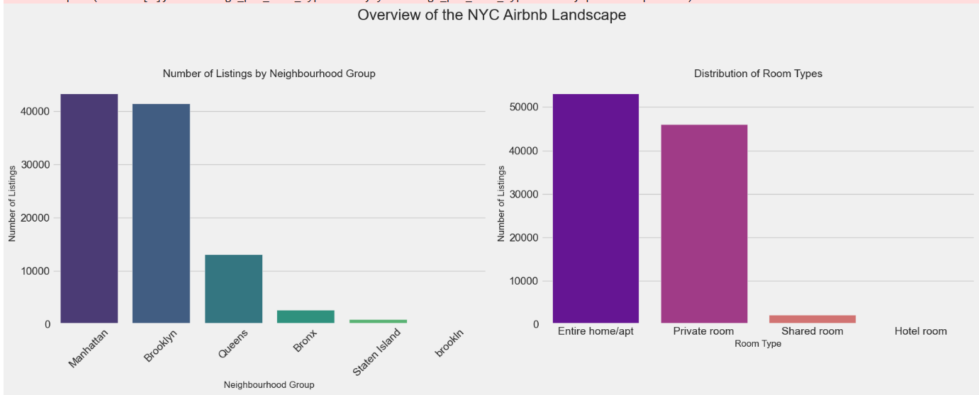
Results 1 - The Landscape of NYC Listings
Where are the Listings and What Kind are They?
Key Finding 1: Manhattan and Brooklyn dominate the Airbnb market, hosting the vast majority of all listings in New York City.
Key Finding 2: The most common type of listing is the 'Entire home/apt', followed by 'Private room', indicating a preference for privacy among guests.

Slide 7
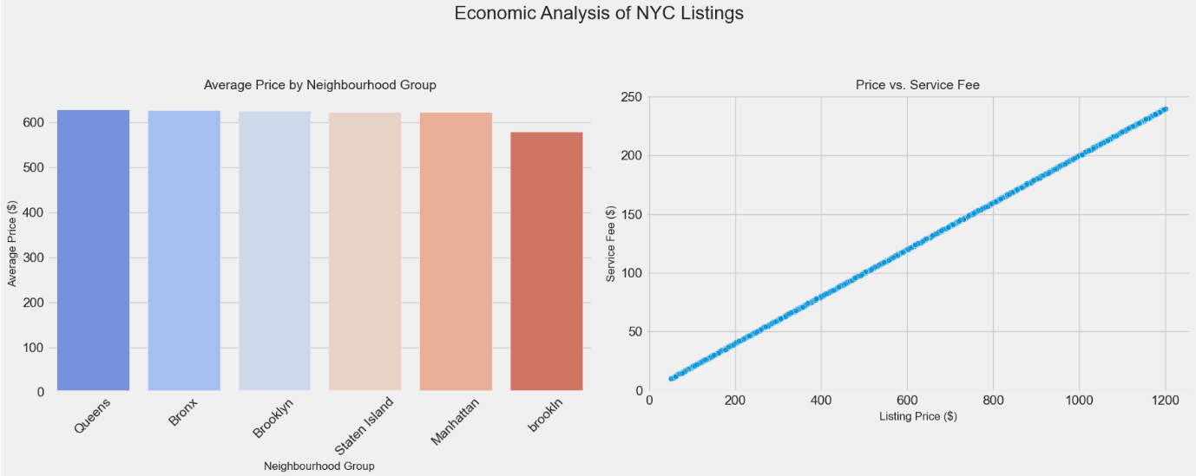
Results 2 - The Economics of Airbnb
What Drives the Price? Location and Fees
Key Finding 1: Manhattan is, by a significant margin, the most expensive borough for Airbnb rentals, reflecting its high real estate value and demand.
Key Finding 2: A strong, direct correlation exists between the listing price and the service fee. As the price goes up, the service fee increases proportionally, indicating it's likely a percentage-based charge.

Slide 8
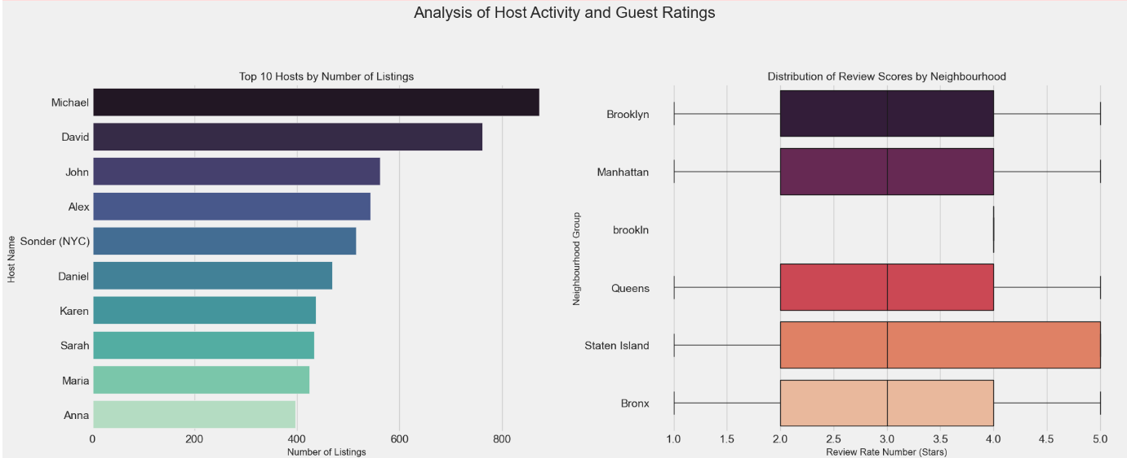
Results 3 - Host Activity & Reputation
Understanding Host Behavior and Guest Satisfaction
Key Finding 1: A small number of hosts manage a large portfolio of properties, with the top 10 hosts collectively listing hundreds of locations.
Key Finding 2: The average review rating is generally high across the platform (around 4 stars), but there are slight variations based on location and room type.

Slide 9
Conclusion & Future Work
Key Takeaways and Next Steps
Conclusion:
Our analysis reveals that the NYC Airbnb market is heavily influenced by location and property type. Manhattan remains the premium market for both price and density. While guest satisfaction is generally high, there is a clear concentration of listings managed by a few power-hosts.
Future Work:
The logical next step is to leverage these insights to build a predictive machine learning model. This model could accurately estimate a listing's price based on its features, providing a powerful tool for new hosts to price their properties competitively.

Slide 10
GitHub repository
Vaibhav-153/VOIS_AICTE_Sep2025_VaibhavAdmane

Slide 11
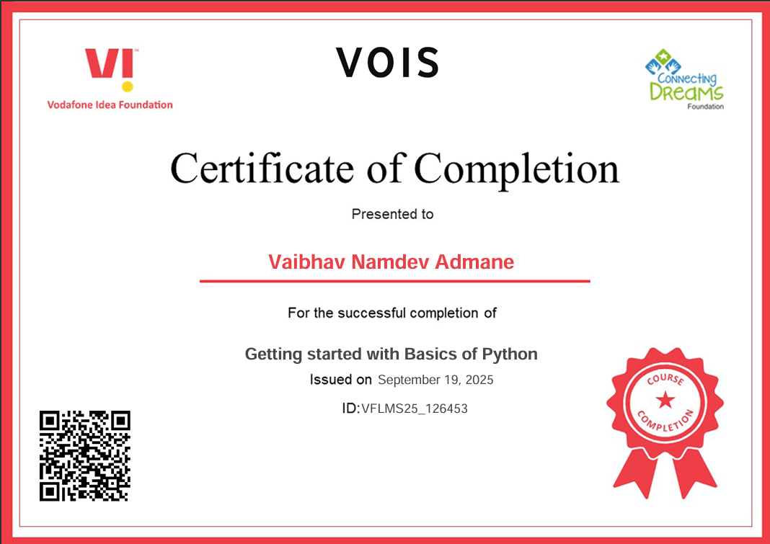
Getting started with Basics of Python Certificate

Slide 12
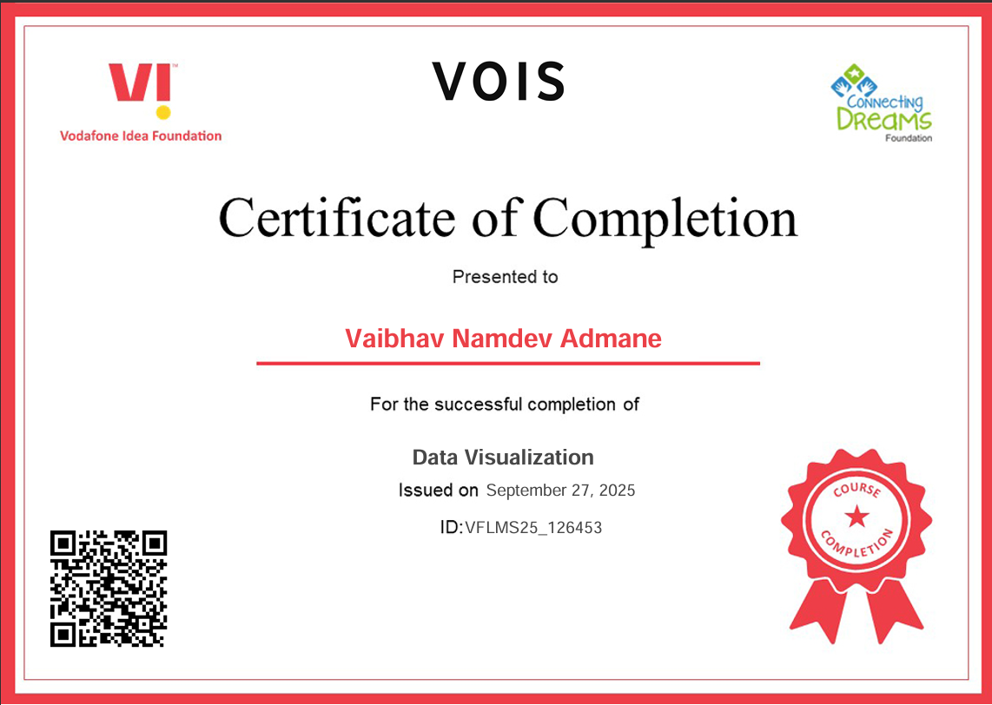
Data Visualization Certificate

Slide 13
Thank you
.

